Slide 1
Airbnb data mining
An exploration of ratings of Airbnb in Paris
ran Tao

Slide 2


Why study the ratings of Airbnb in Paris?
Nowadays, more and more travelers are choosing Airbnb over hotel because of its low cost, convenient location and household amenities especially in Europe.
Paris, one of the most popular touristic city in Europe, has highest number of Airbnbs.
I want to study the ratings of Airbnbs in Paris to give better recommendation to people who are visiting Paris and also offer advice to Airbnbs host in Paris

Slide 3
What’s the goal of this study?
Discover the factors that affect the ratings of Airbnbs in Paris
Discover the distribution of ratings between districts and within districts
What’s the implication of this study?
For Airbnb hosts: have a better understanding of the preference of customers
For Airbnb guests: improve of their knowledge of choosing Airbnb in different districts

Slide 4
Methods
Data source: single survey for Paris with 70,158 listing properties as of 25th July 2017, which is collected from the public Airbnb website
Study population: 50,406 listing Airbnb properties in Paris, we exclude the 19,752 listing properties which have no reviews in our dataset
Outcome definition:
Satisfaction: YES (weighted average >=2); No (weighted average <2)
Weighted average ratings=average overall satisfaction * weight
Weight= sigmoid function (number of reviews)

Slide 5
Room id | A unique number identifying an Airbnb listing
Host id | A unique number identifying an Airbnb host
Room type | One of Entire home/apt, Private room, or Shared room
Neighborhood | a sub-region of the city or search area for which the survey is carried out
Reviews | The number of reviews that a listing has received
Overall satisfaction | The average rating (out of five) that the listing has received from those visitors who left a review
Accommodates | The number of guests a listing can accommodate
Bedrooms | The number of bedrooms a listing offers
price | The price (in $US) for a night stay
Latitude and longitude | The latitude and longitude of the listing as posted on the Airbnb

Slide 6
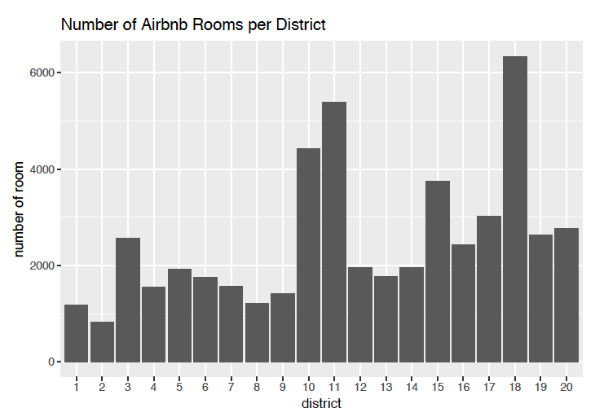
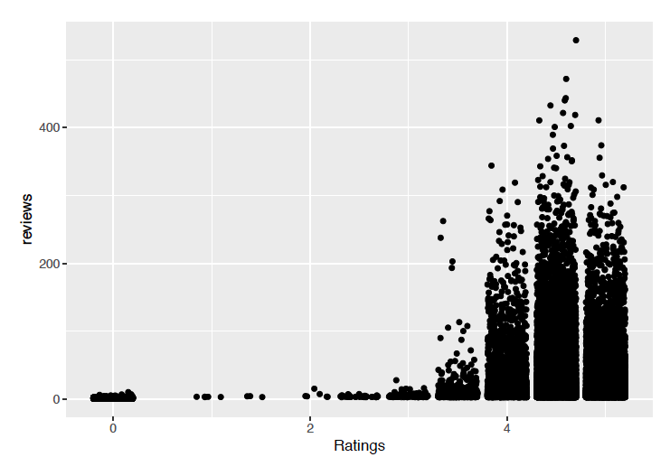
EDA
the sample size in each district is relative large
generally higher ratings tend to have more reviews
817

Slide 7
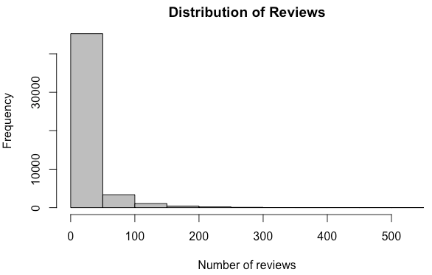
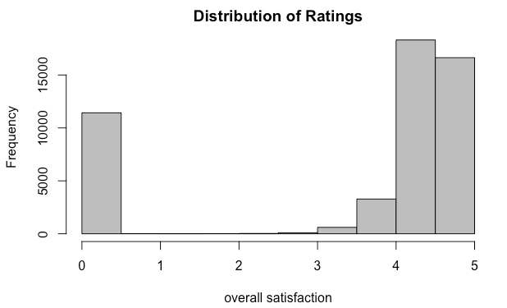
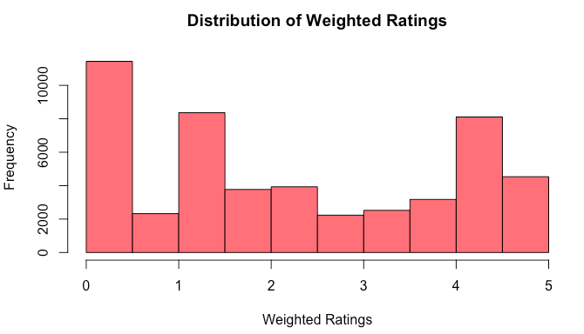
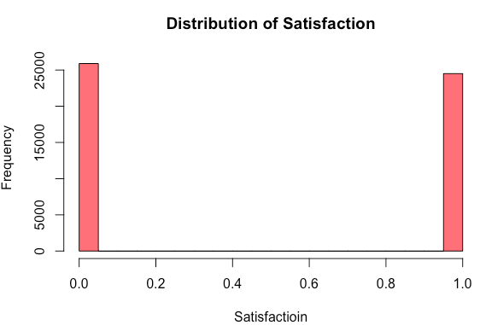
89.7% of total Airbnb rooms have less than 50 reviews
22.7% of rooms with ratings less than 1, 75% of room with ratings higher than 4
25,898
24,508
Non-normal
skewness
Weighted rating>=2, satisfactory
Weighted rating<2, not satisfactory
51% of Airbnbs are not satisfactory,
49% of Airbnbs are satisfactory

Slide 8
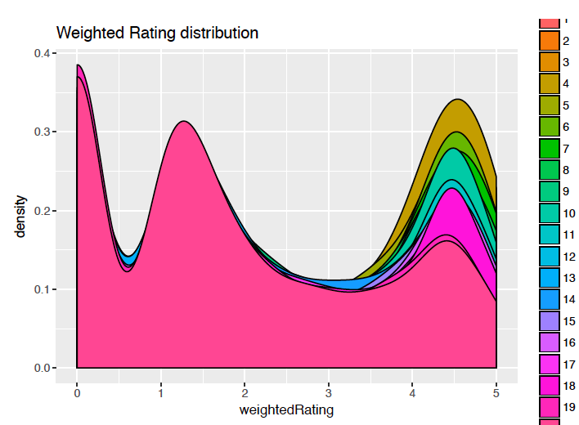
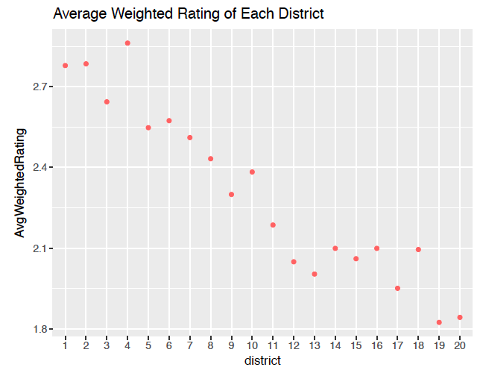
EDA
The distributions of weighted ratings are different between districts
The mean of weighted rating of each district varies

Slide 9
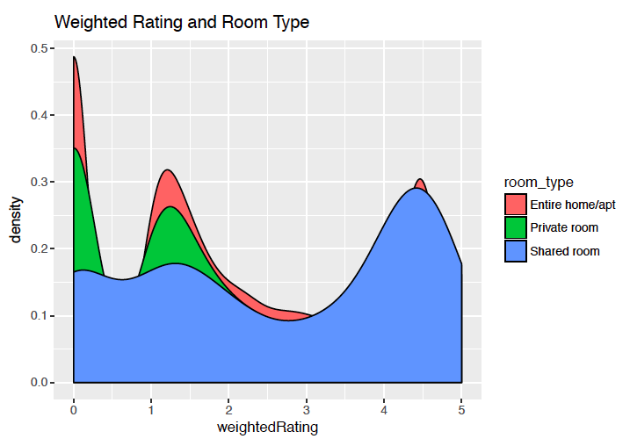
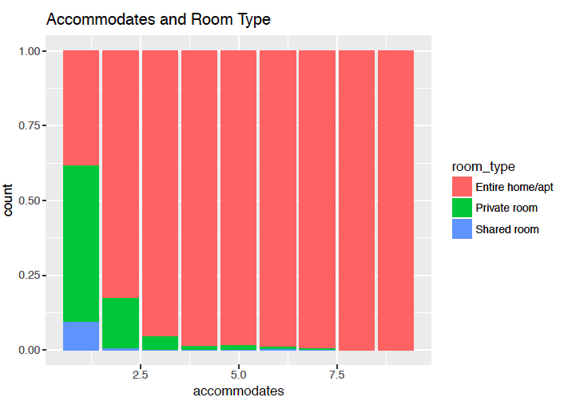
Shared room tends to have higher weighted ratings
Interaction between room type and accommodate
Entire room tends to allow more accommodates
EDA

Slide 10
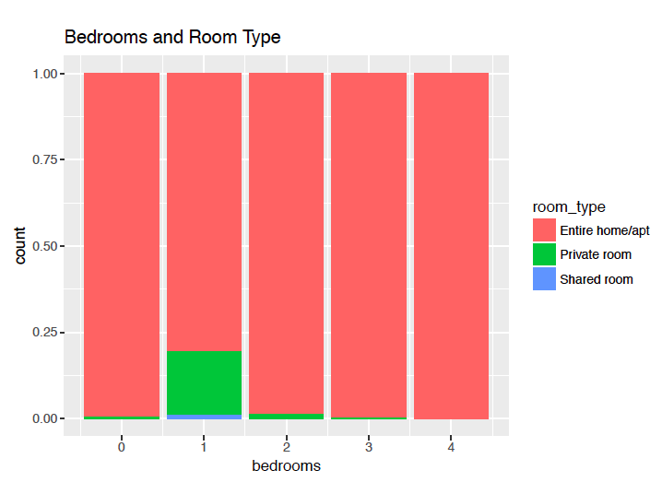
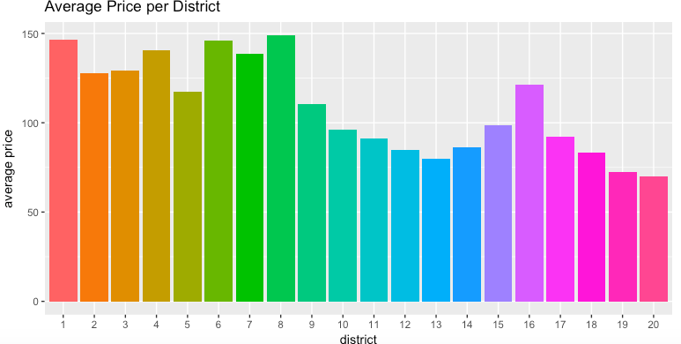
No obvious interaction between room type and bedrooms
Price varies between district
EDA

Slide 11
Analysis - Descriptive statistics
Satisfaction | No | Yes
Binary | 25,898 | 24,508
Room type | Entire room/Apt | Private room | Shared room
Category | 44,418 | 5,612 | 376
Accommodate | Min | 1st Qu | Median | Mean | 3rd Qu | Max
Numeric | 1 | 2 | 2 | 3 | 4 | 9
Bedrooms | Min | 1st Qu | Median | Mean | 3rd Qu | Max
Numeric | 0 | 1 | 1 | 1 | 1 | 4
Price | Min | 1st Qu | Median | Mean | 3rd Qu | Max
Numeric | 11.0 | 60.0 | 84.0 | 101.3 | 119.0 | 555.0
Violence rate | Min | 1st Qu | Median | Mean | 3rd Qu | Max
Numeric | 3.3 | 4.6 | 5.7 | 7.5 | 8.7 | 33.3

Slide 12
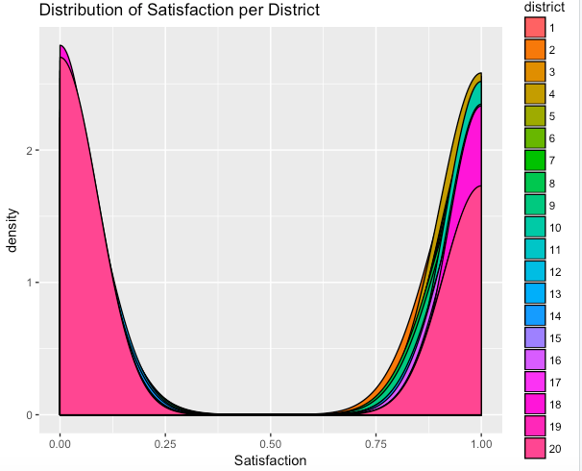
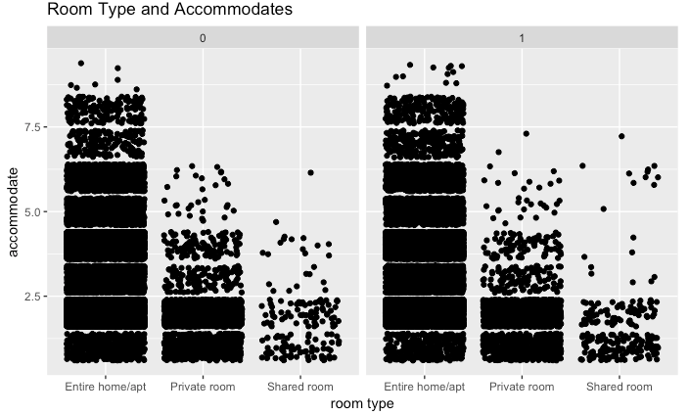
EDA
Interaction between room type and accommodates
The distributions of satisfaction are different between district

Slide 13
Analysis
Analytical Approach: multilevel logistic regression
Group level: districts
Individual level: per Airbnb
Dependent variable | Satisfaction: binary variable Yes: weighted average rating >=2 No: weighted average rating<2
Independent variable Group level | Violence rate: per 1000 inhabitants of each district Data source: www.lefigaro.fr
Independent variable Individual level | Room type, Accommodates Bedrooms Price

Slide 14
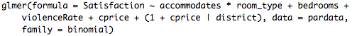
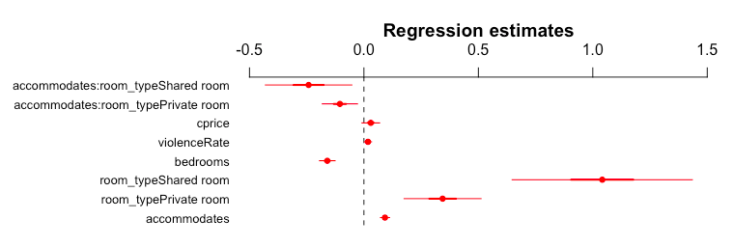
Standardized price

Slide 15
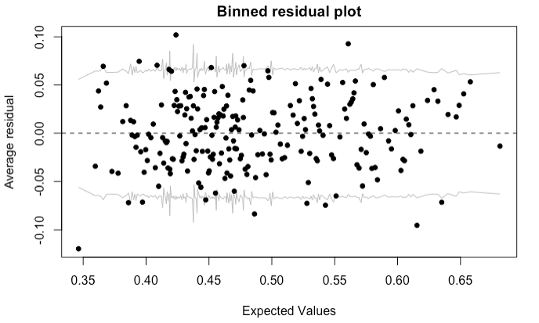
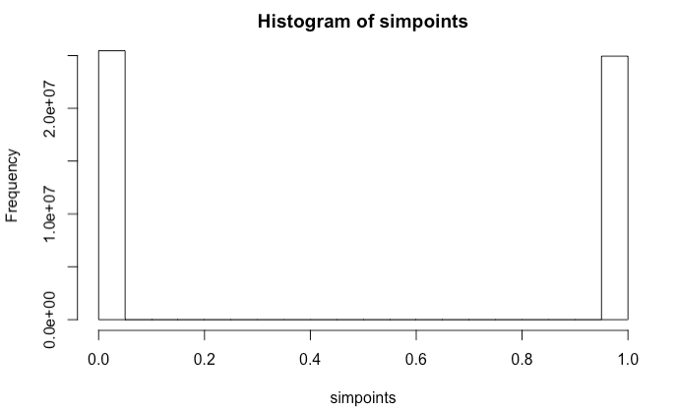
Model Diagnosis
Residual Analysis Predictive Checking
Sim: 49.49% satisfaction
VS
Original data: 48.62% satisfaction
Pretty good fit of the data

Slide 16
Implications-Fixed Effect
Price
Violence rate
Room type
Shared room Entire room
Private room
accommodate
Bedrooms
Negative effect
Positive effect
Positive effect
Negative effect
Positive effect
the probability of being satisfied on average

Slide 17
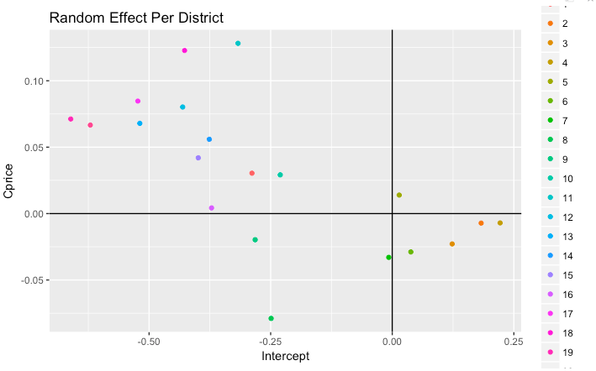
Implications-Random Effect
Random intercept: we can see 2,3,4,5,6 districts have positive intercept, which means they have higher probability of being satisfied with average price than other districts when other variables are same
Random slope: we can see 2,3,4,6,7,8,9 districts have negative slope, which means each unit increase of price deviating from average price over standard error will decrease probability of being satisfied, while other districts have positive slope
Potential Districts
Star Districts
Problem
Districts
Golden Districts

Slide 18
Star District (positive random intercept and random slope): district 5th Airbnbs in this district have higher probability of being satisfied generally, and there is still potential for Airbnb hosts to increase the price | Golden District (positive random intercept but negative random slope): district 2nd, 3rd, 4th, 6th, 7th Airbnbs in this district have higher probability of being satisfied generally, but they are already highly priced, further increase in price will decrease the ratings
Potential District (negative random intercept and random slope): district 1st, 10th, 11th, 12th, 13th, 14th, 15th, 16th, 17th, 18th, 19th, 20th Airbnbs in this district have lower probability of being satisfied generally, but there is still potential for Airbnb hosts to increase the price | Problem District (negative random intercept and random slope): district 8th, 9th Airbnbs in this district have lower probability of being satisfied generally, but they are already highly priced, further increase in price will decrease the ratings

Slide 19
Recommendations
For Airbnb host:
Shared room and private room tend to be favored by guest
Increasing the accommodate of entire room could attract guests
Downtown area is preferred by guests despite of the high violence rate
Property with many bedrooms are not welcomed by guests
Airbnb hosts in star and potential district can increase the price
Airbnb hosts in problem and golden district better not increase price, otherwise ratings would be negatively impacted
For Airbnb guest:
If you have enough budget and prefer a comfortable place for stay, you can choose Airbnb in star districts
If you don’t mind high price and prefer a comfortable place for stay, you can choose Airbnb in golden district
If you have limited budget and don’t have preference for the place to stay, you can choose Airbnb in potential districts

Slide 20
Study limitations
1) Time limitation
The data only contained the listing properties as of 25th July, which couldn’t display a full picture of the ratings in terms of trend over time.
2) Data limitation
We don’t have the text data per review, with which we can carry out further text analysis.

Slide 21
Appendix
http://tomslee.net/airbnb-data-collection-get-the-data
http://www.developintelligence.com/blog/2017/06/practical-neural-networks-keras-classifying-yelp-reviews/
Andrew Gelman, Data Analysis Using Regression and Multilevel/Hierarchical Models, 1st Edition, 2006
http://www.lefigaro.fr/actualite-france/2017/01/02/01016-20170102ARTFIG00290-decouvrez-la-carte-des-crimes-et-delits-en-france-et-dans-le-grand-paris.php

